Slide 1
For Normal Windows
(When there is some space between wall and window)
Step1:
Measure the exact width of the window frame for 3 places (top, middle, and bottom).
Taking measurement from 3 places is to ensure that the window grid is parallel to the wall.
Top
1620mm
Step2:
Add 100mm to the total width.
Example. 1620mm + 100mm = 1720mm
Middle
1620mm
2300mm
Step3:
Measure the height you would like the blind to cover (ensure the height is enough to cover the entire window). Minimum of 50mm or 5cm allowance will be required for the installation above the top window frame.
Recommendation: Height measurement, top to bottom window frame total measurement, add 100mm or 10cm to each end for optimum coverage.
Example. 2300mm + 100mm (top) + 100mm (bottom) = 2500mm
In the event there are insufficient space for height allowance (eg full height windows), the addition of top/bottom allowance is not required
Bottom
1620mm
Window Frame

Slide 2
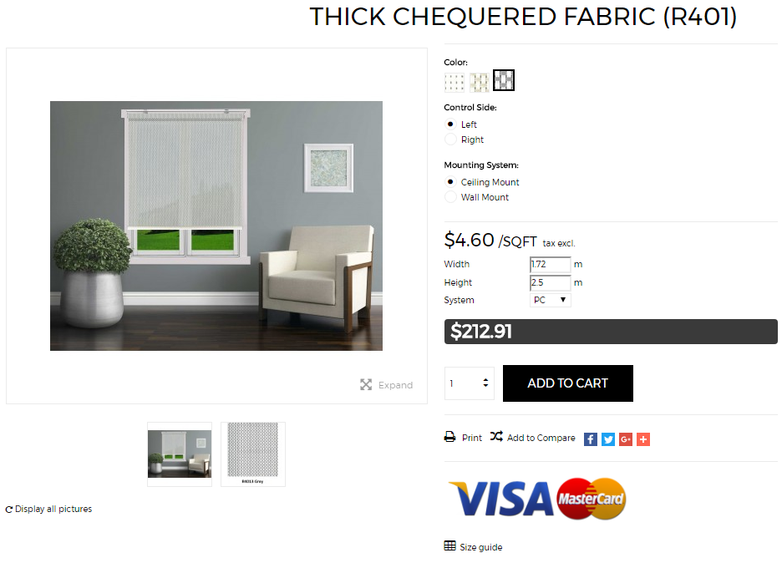
For Normal Windows
(When there is some space between wall and window)
Input Width and Height
Width
Example.
Measured Width = 1620mm
After Width Addition = 1620+100mm
= 1720mm
Input measurements = 1720mm
= 1.720m
Height
Example.
Measured Height with allowance = 2300mm After Height Addition = 2300 + 200mm
= 2500mm
Input Height = 2500mm
= 2.5m
Top
1620mm
Middle
1620mm
2300mm
Bottom
1620mm
Window Frame

Slide 3
For Normal Windows
(When there is some space between wall and window)
1 Venetian Blind for 2 Panels
1 Roller Blind for 2 Panels
Blind
Width
Blind Width
1720mm
1720mm
Blind Height
Blind Height
2500mm
2500mm
Window Frame

Slide 4
For Normal Windows
(When there is some space between wall and window)
2 Venetian Blinds for 2 Panels
2 Roller Blinds for 2 Panels
Blind
Width
860mm
(1720mm÷2)
Blind Width
860mm
(1720mm÷2)
Blind Height
2500mm
Blind Height
2500mm
Window Frame

Slide 5
For Wall-to-wall Windows
(When there are no space between wall and window)
Step1:
Measure the exact width of the window frame for 3 places (top, middle, and bottom).
Taking measurement from 3 places is to ensure that the window grid is parallel to the wall.
Top
1520mm
Middle
Step2:
Deduct 5mm from the total width.
Example. 1520mm – 5mm = 1515mm
1520mm
2300mm
Bottom
1520mm
Step3:
Measure the height you would like the blind to cover (ensure the height is enough to cover the entire window). Minimum of 50mm or 5cm allowance will be required for the installation above the top window frame.
Recommendation: Height measurement, top to bottom window frame total measurement, add 100mm or 10cm to each end for optimum coverage.
Example. 2300mm + 100mm (top) + 100mm (bottom) = 2500mm
Window Frame

Slide 6
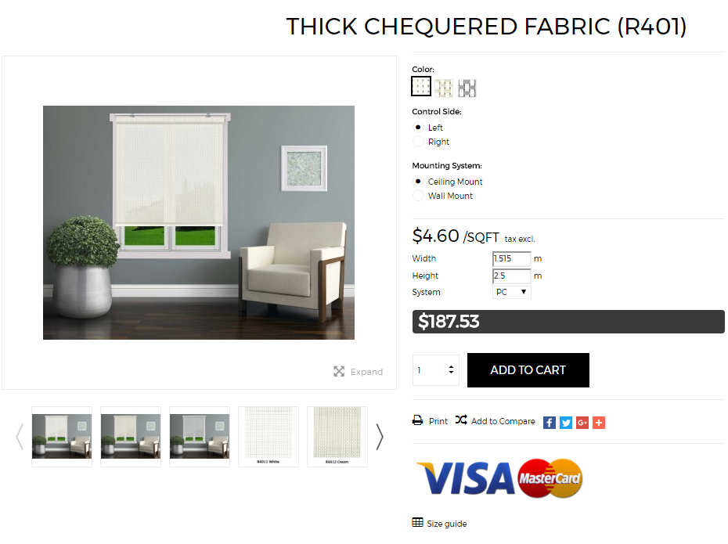
For Wall-to-wall Windows
(When there are no space between wall and window)
Input Width and Height
Width
Example.
Measured Width = 1520mm
After Width Deduction = 1520-5mm
= 1515mm
Input measurements = 1515mm
= 1.515m
Height
Example.
Measured Height with allowance = 2300mm After Height Addition = 2300 + 200mm
= 2500mm
Input Height = 2500mm
= 2.5m
Top
1520mm
Middle
1520mm
2300mm
Bottom
1520mm
Window Frame

Slide 7
For Wall-to-wall Windows
(When there are no space between wall and window)
1 Venetian Blind for 2 Panels
1 Roller Blind for 2 Panels
Blind
Width
Blind Width
1515mm
1515mm
Blind Height
Blind Height
2500mm
2500mm
Window Frame

Slide 8
For Wall-to-wall Windows
(When there are no space between wall and window)
2 Venetian Blinds for 2 Panels
2 Roller Blinds for 2 Panels
Blind
Width
Blind Width
757mm
(1515mm÷2)
757mm
(1515mm÷2)
Blind Height
Blind Height
2500mm
2500mm
Window Frame

Slide 9
For Wall-to-wall Windows
(When there are no space between wall and window)
Additional Notes for Measurements within a Frame:
Measurement for blinds WITHIN frame is similar to measuring wall-to-wall windows.
Width Measurements:
Deduct 5mm from measured width
(eg 1520mm – 5mm = 1515mm)
Height Measurements:
For Venetian Blinds,
Deduct around 16mm from measured height.
(Allowance for tilting of Venetian Blinds)
(eg 2300mm – 16mm = 2284mm)
For other types of blinds,
Deductions for Height are not needed.
Other Considerations:
Take note of any other protruding objects within the frame that may hinder the operation of the blinds (eg mullions). In the event that there are protruding mullions within the frame, the measurements of the width should be from frame to mullion, and then from the mullion to the other side of the frame.
Top
1520mm
Middle
1520mm
Bottom
1520mm
2300mm
Window Frame

Slide 10
4 TYPES OF WINDOWS AND HOW TO MEASURE THEM
Window Type | Normal | Wall-to-Wall Or Within Mullions | Full-Height | Fully Constrained (Full-Height + Wall-to-Wall or within fixed frame)
Illustration
Blind Height | Window Height + 100mm (top allowance) + 100mm (bottom allowance) | Window Height + 100mm (top allowance) + 100mm (bottom allowance) | Window Height - 15mm (venetian blinds only) | Window Height - 15mm (venetian blinds only)
Blind Width | Window Width + 50mm (left allowance) + 50mm (right allowance) | Window Width - 5mm | Window Width + 50mm (left allowance) + 50mm (right allowance) | Window Width - 5mm
Recommended Mounting Type | Wall Mount | Wall Mount | Ceiling Mount | Ceiling Mount

